Slide 1
Probability and Statistics Overview
Lecture-2
Slides have been prepared from multiple sources on the Internet. No authorship is claimed.

Slide 2
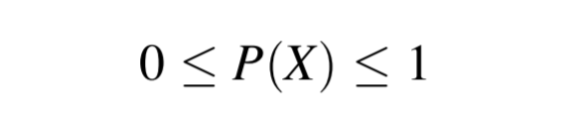
Probability
Notion of likelihood for an event to occur
Prior Probability: P(A)
Posterior Probability: P(A|B)

Slide 3
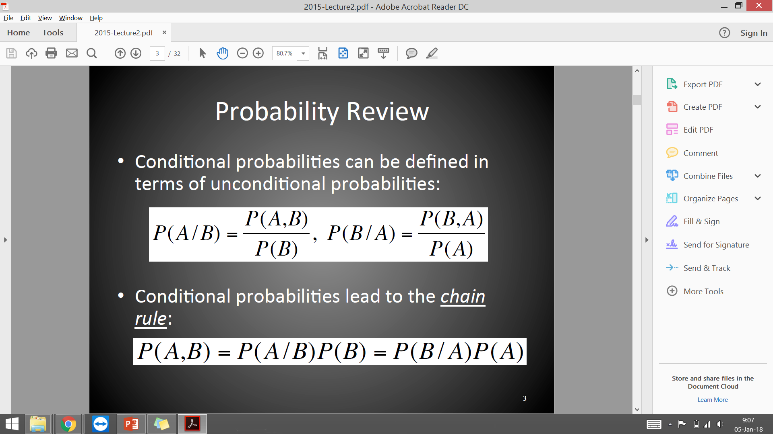
Conditional Probability
Conditional probability of A given B:
Deriving Chain Rule from above:

Slide 4
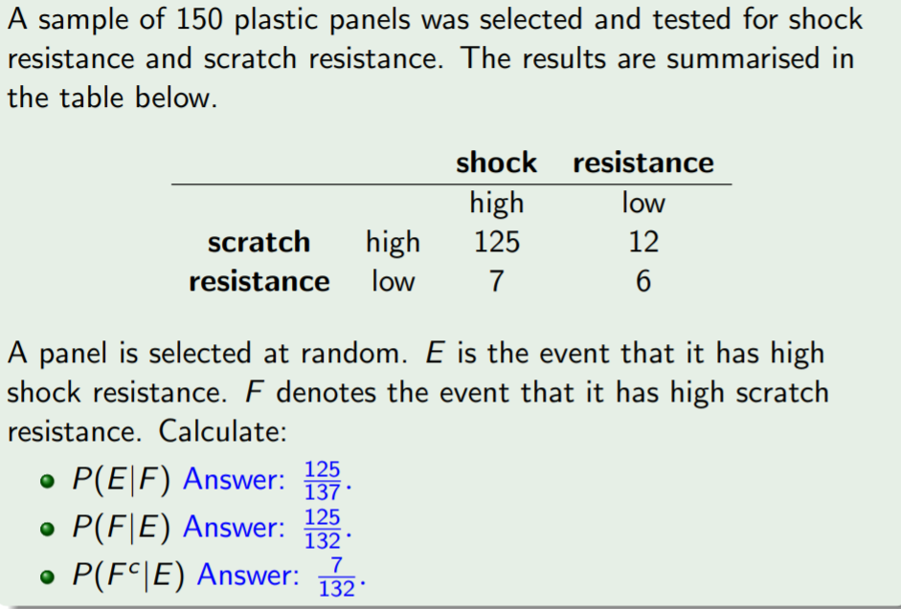

Question

Slide 5
Question

Slide 6
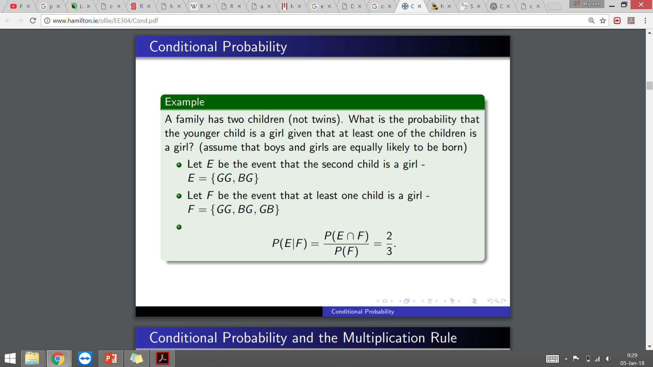
Question

Slide 7
Question

Slide 8
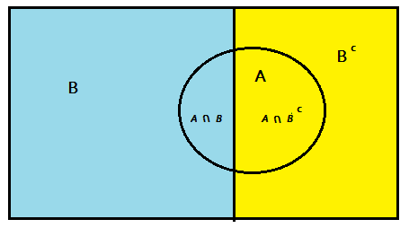
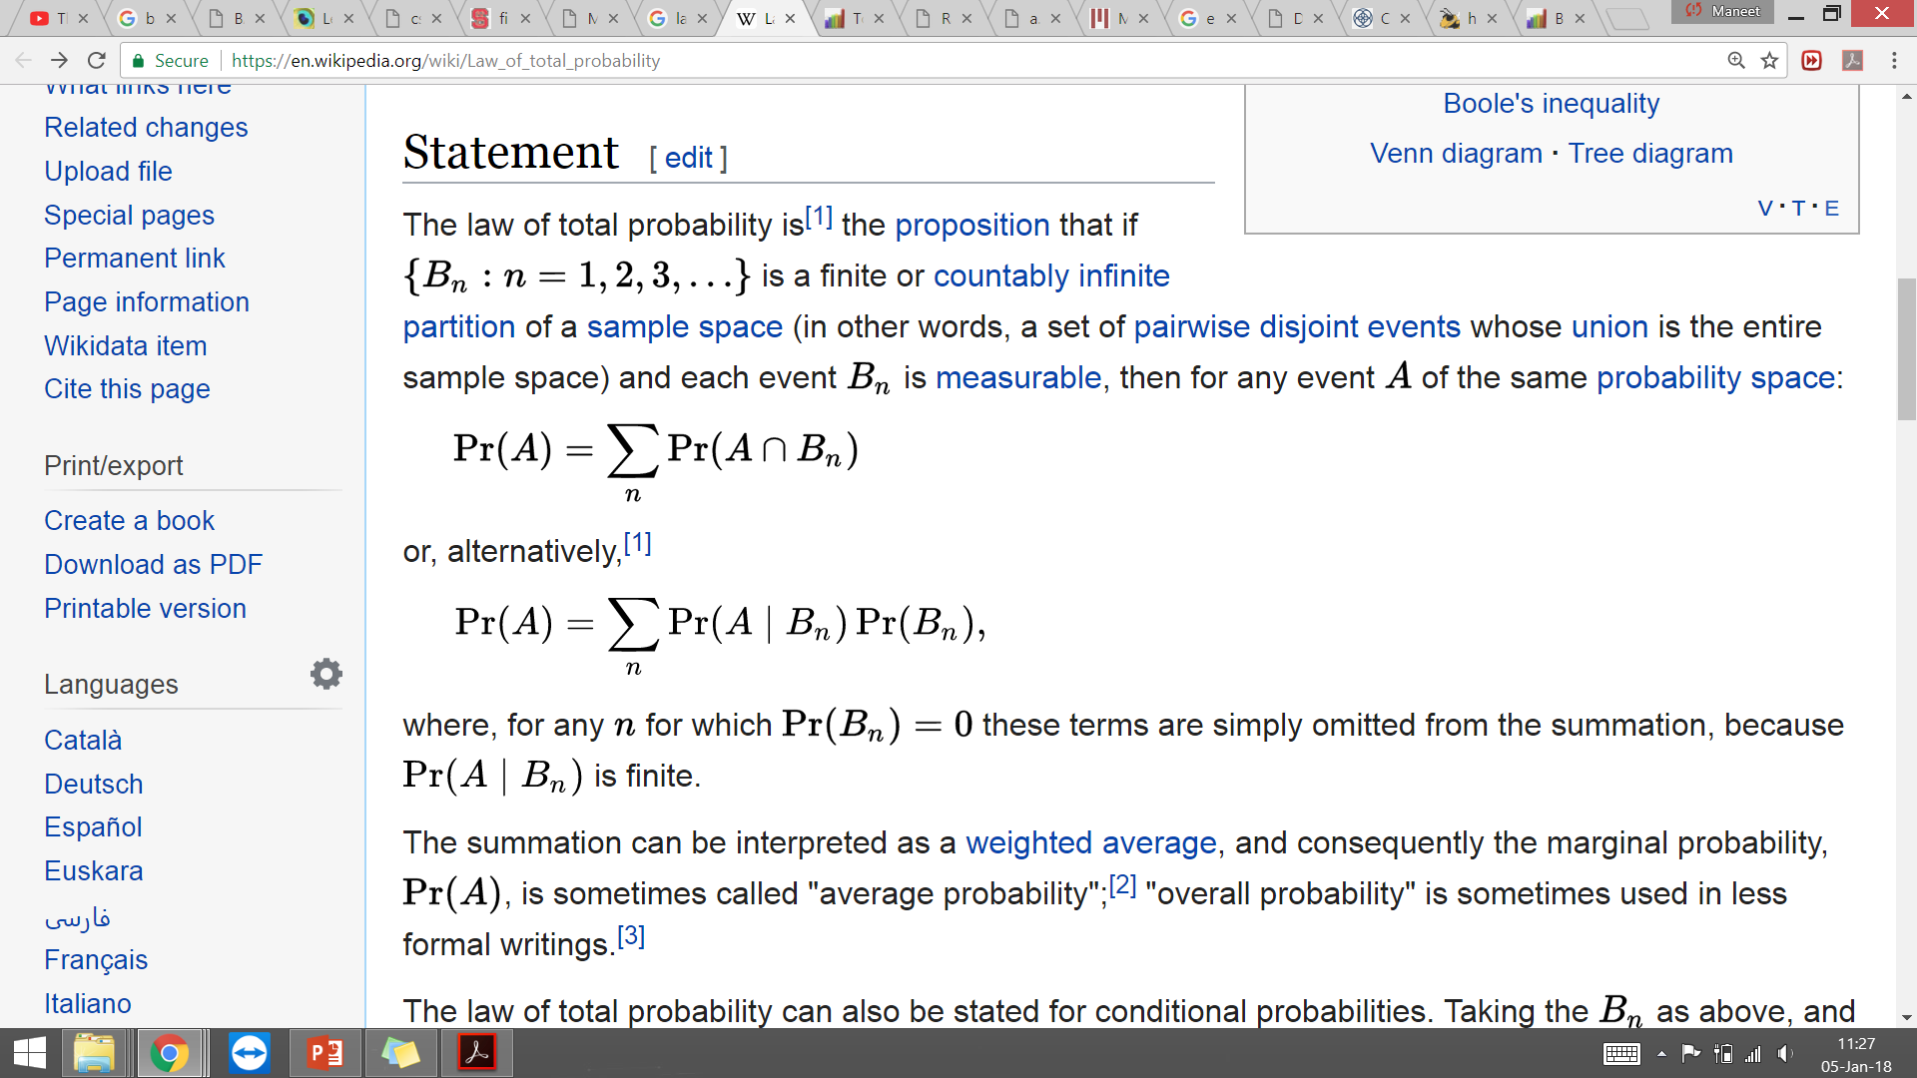
Law of Total Probability
If B₁, B₂, … B_{n} is a partition of mutually exclusive events, and A is any event, then:
P(A) = P(A∩B) + P(A∩B^{c})

Slide 9
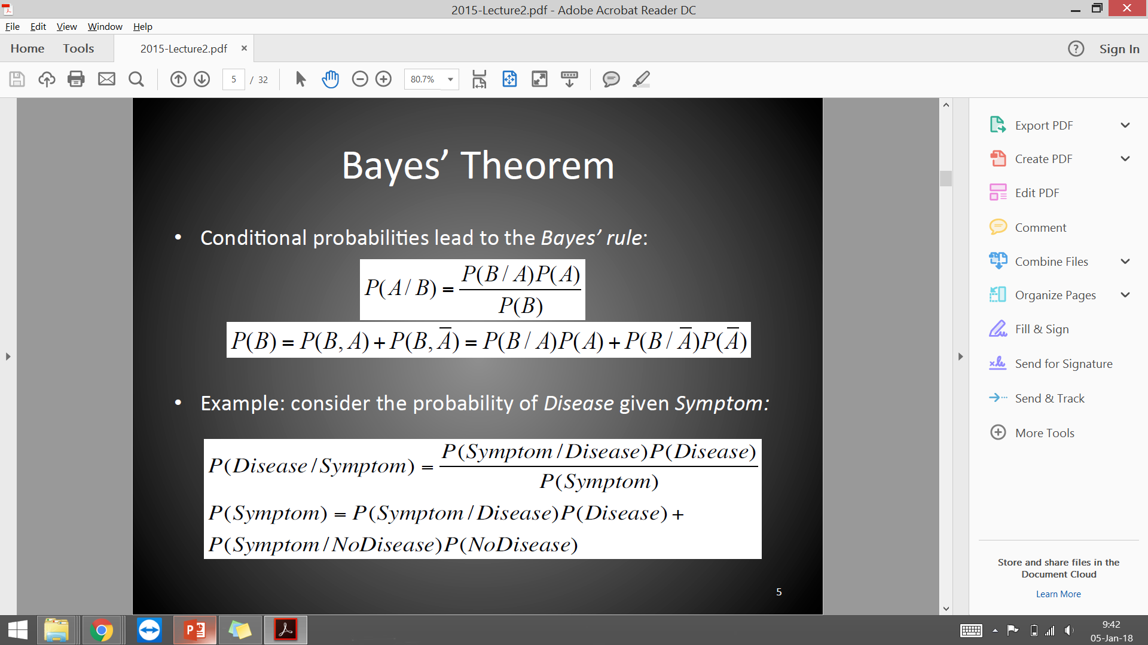
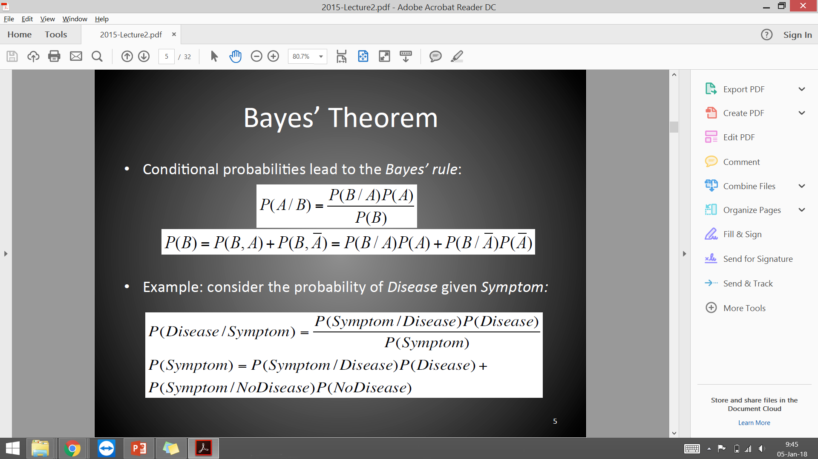
Bayes’ Theorem

Slide 10

Bayes’ Theorem

Slide 11
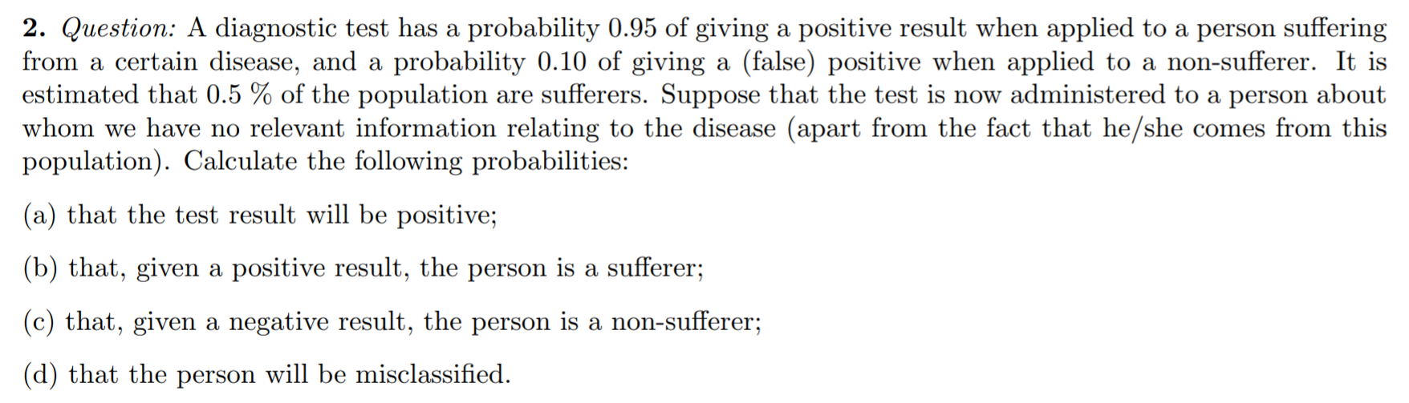
Question

Slide 12
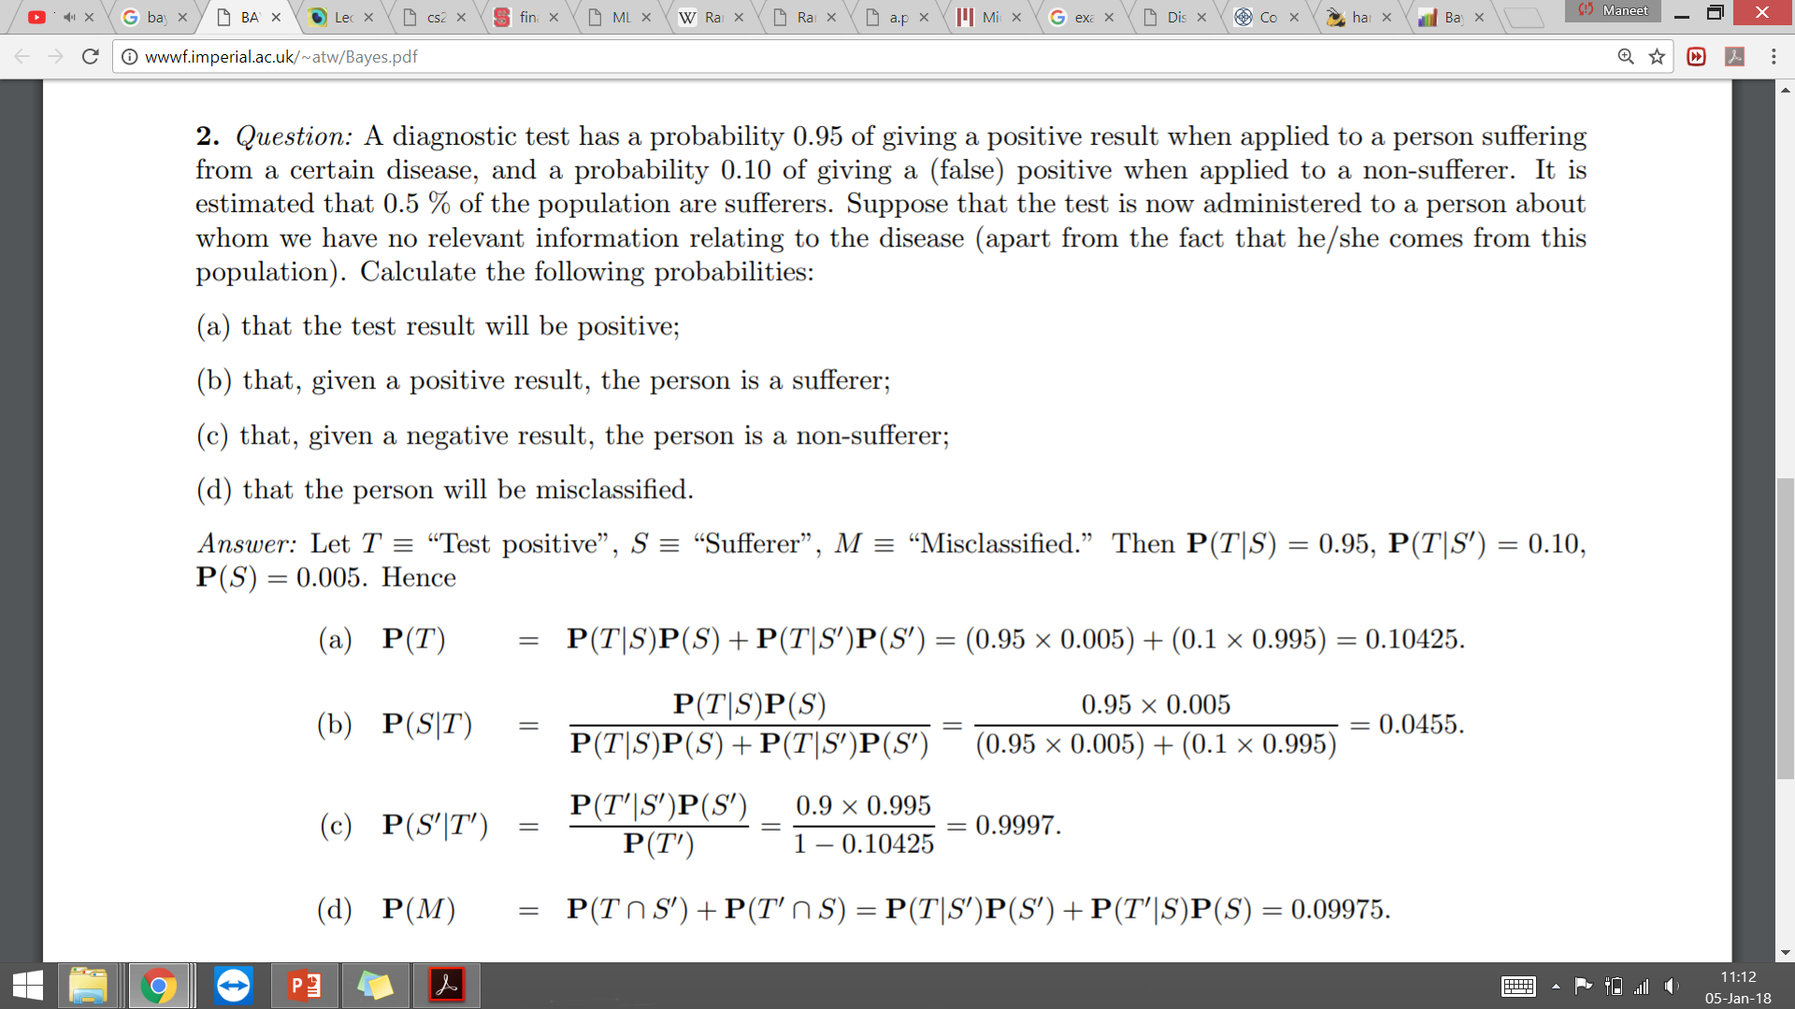

Question

Slide 13

Question

Slide 14

Question

Slide 15

Question

Slide 16
Random Variables
A variable whose possible values are numerical outcomes of a random phenomenon
Discrete Random Variable: Can take countable number of distinct values
Eg: Number of students present, number of students getting A
Continuous Random Variable: Can take infinite number of possible values, generally measurements
Eg: Height, temperature in New Delhi

Slide 17
Random Variables
The probability distribution for a random variable gives the possible values of the variable along with the associated probabilities
For a discrete random variable, the probability distribution is called the probability mass function (pmf)
For a continuous random variable, the probability distribution is called the probability density function (pdf)

Slide 18
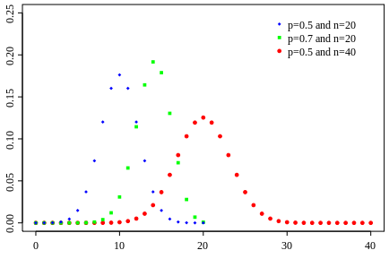
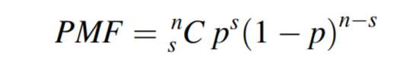
Discrete Distribution: Binomial Distribution
Often encountered when same experiment is repeated multiple times
Experiment is of pass/fail or yes/no type
Probability of success: `p’, probability of failure: `1-p’ n: total number of iterations of experiment, s: number of successes
Probability
Iterations

Slide 19
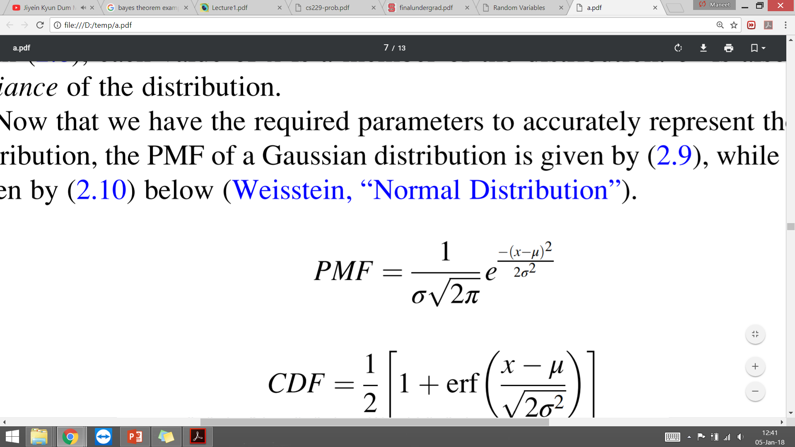
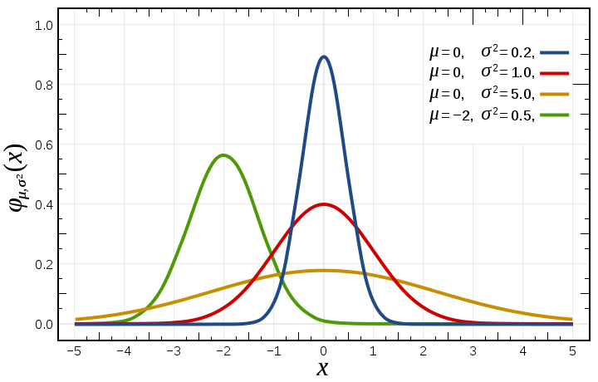
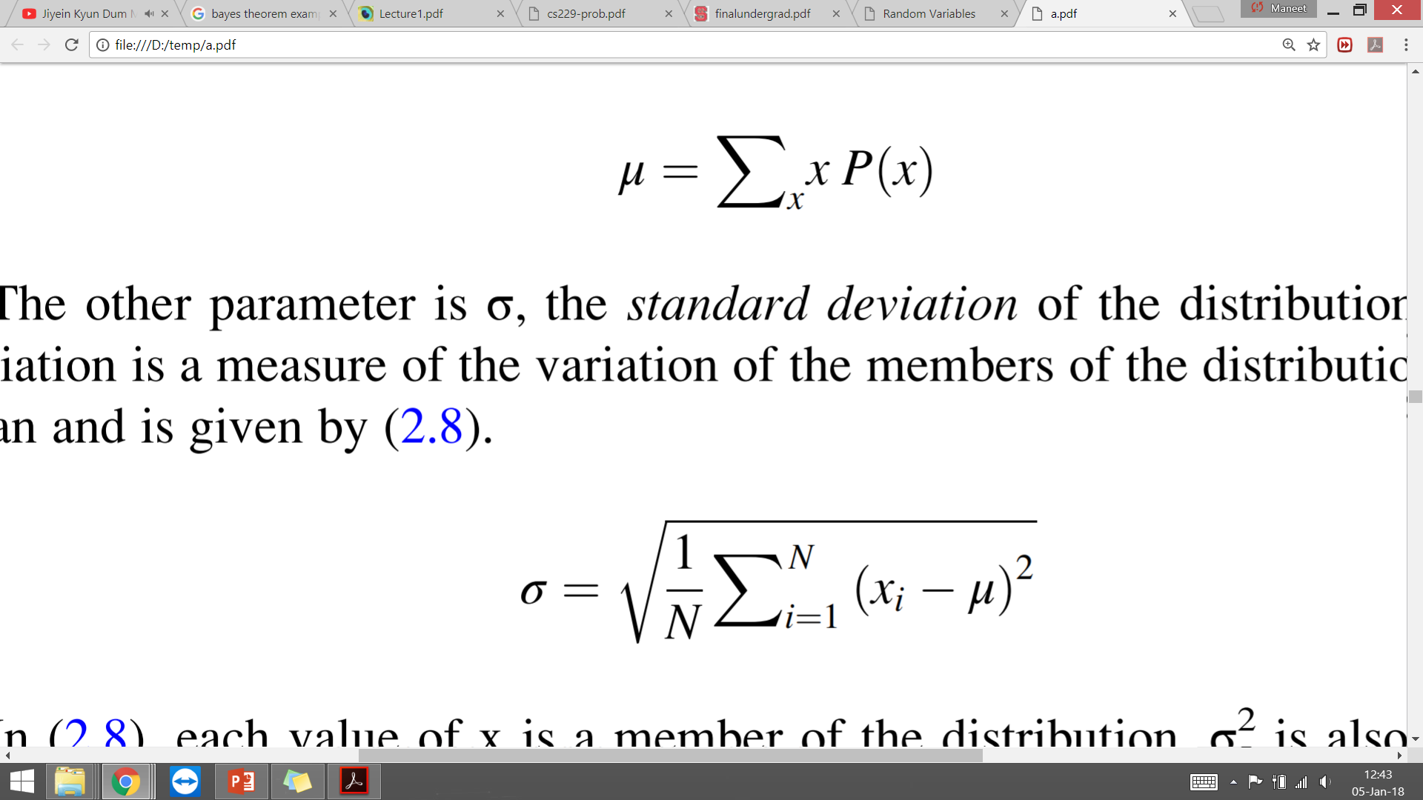
Continuous Distribution: Gaussian

Slide 21
Expectation
Variance
Correlation
Central limit theorem
Parameter estimation,
hypothesis testing (t-test)

Slide 22
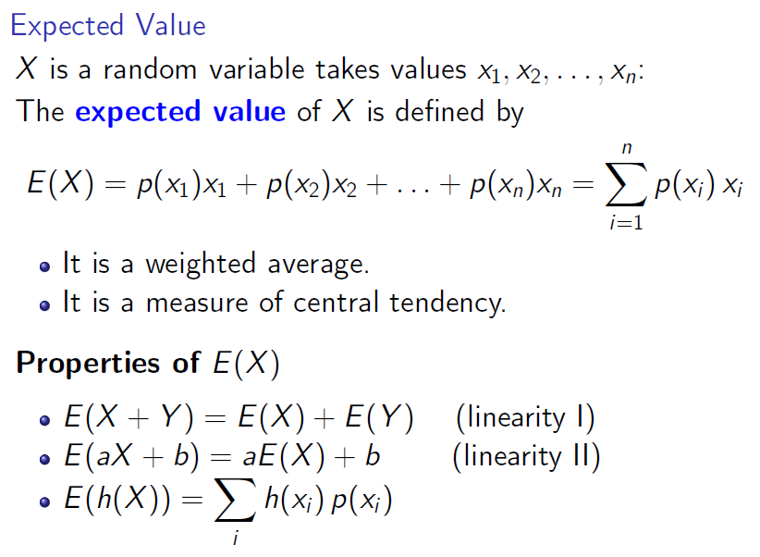

Slide 23
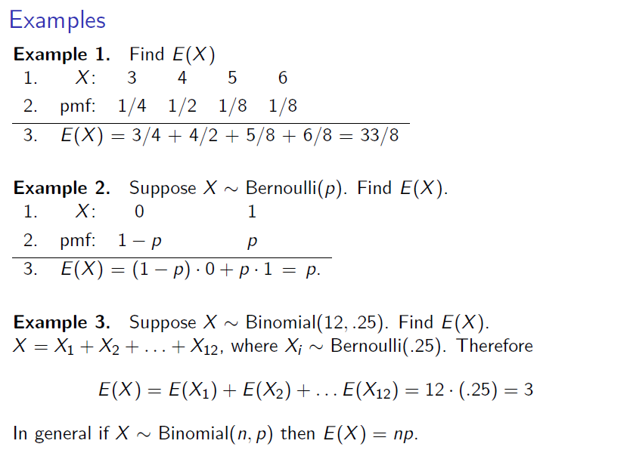

Slide 24
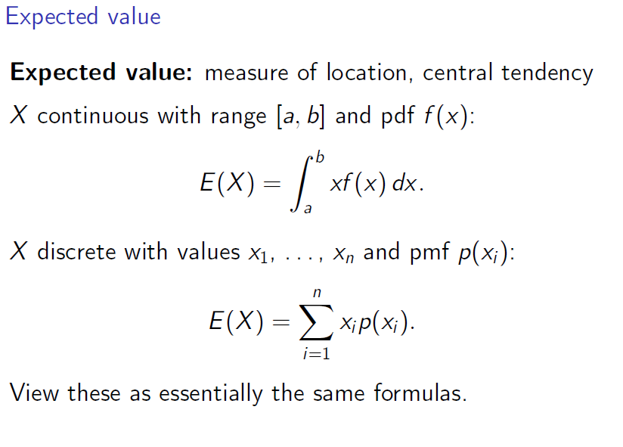

Slide 25
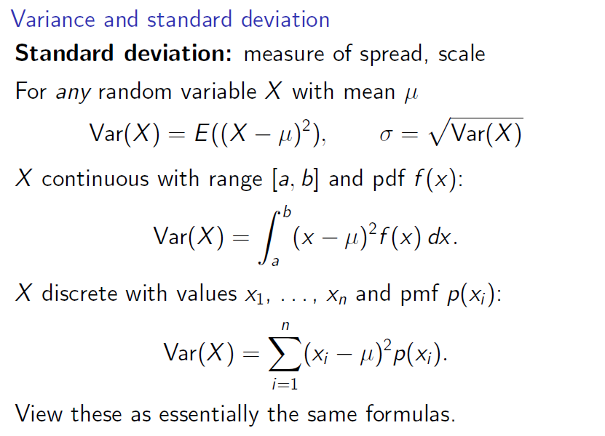

Slide 26
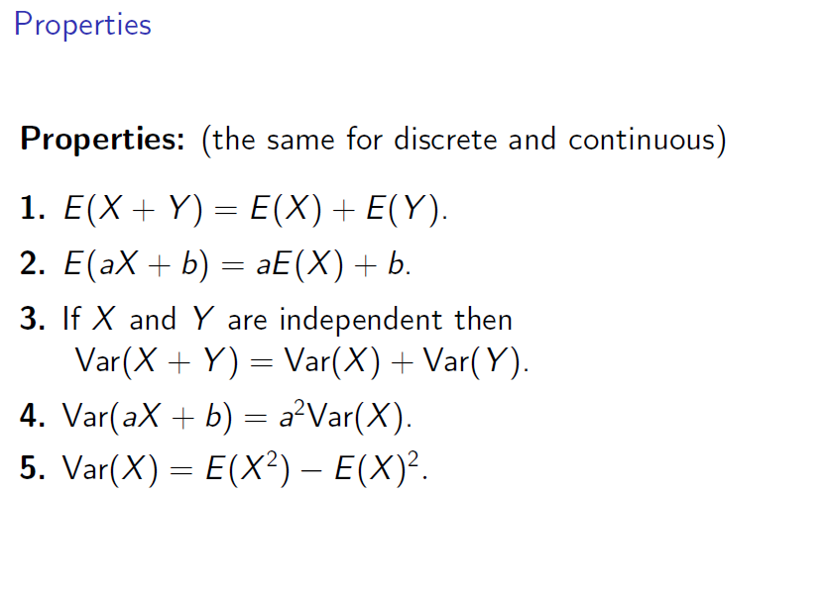

Slide 27
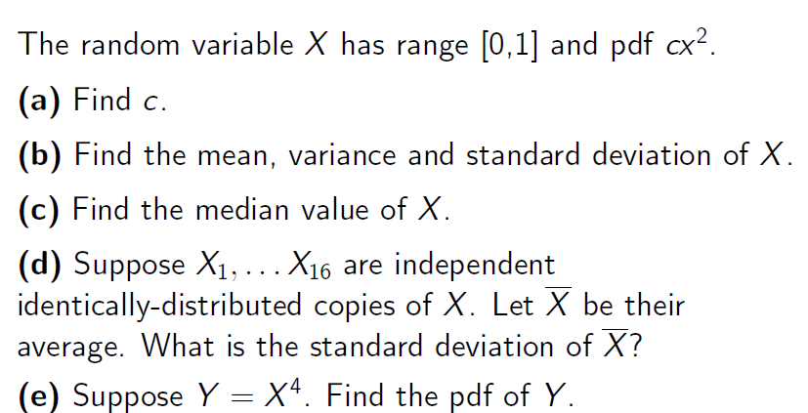
Practice question

Slide 28
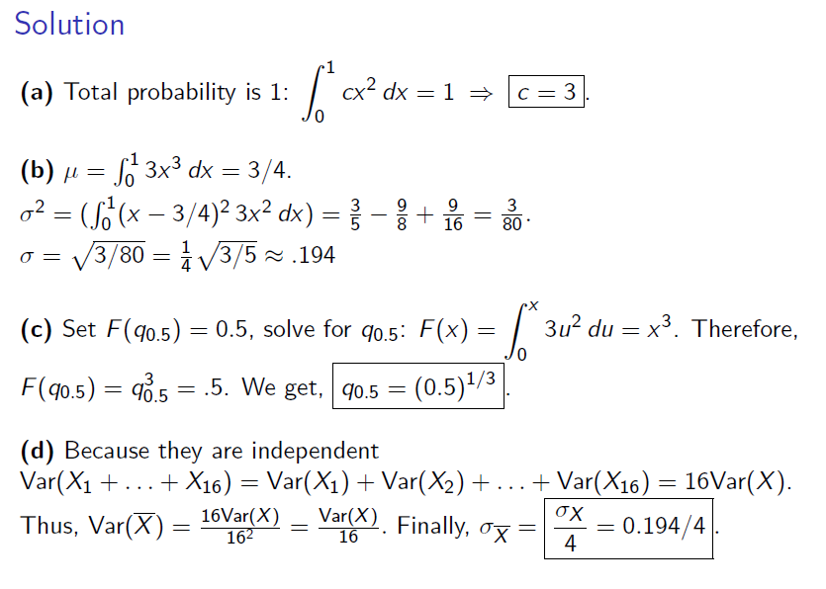

Slide 29
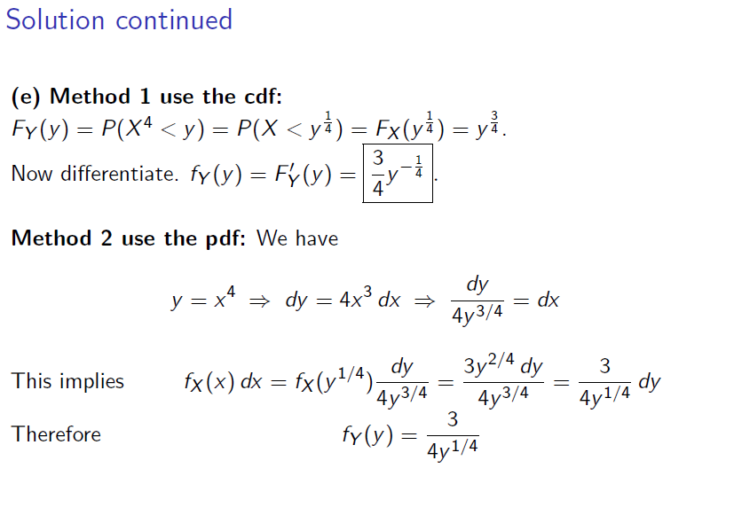

Slide 30
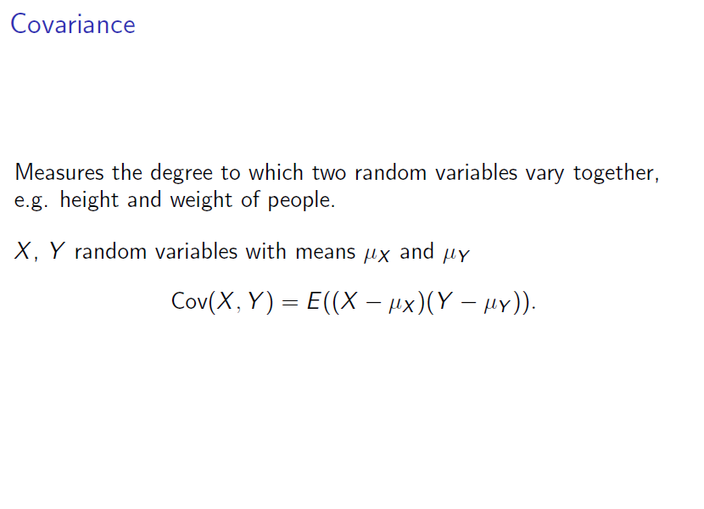

Slide 31
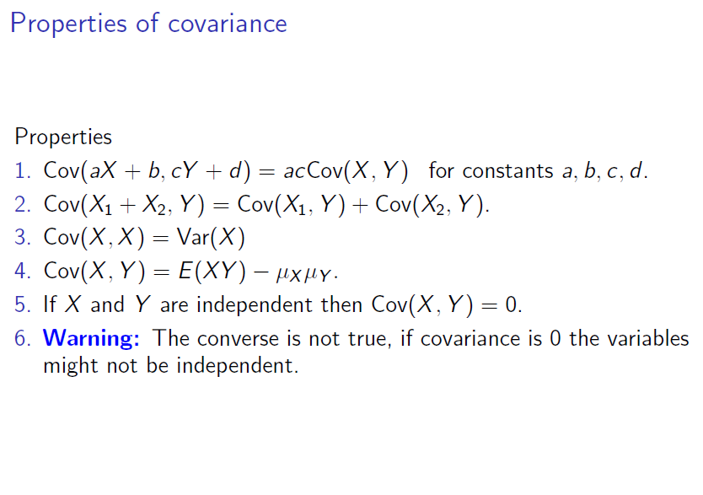

Slide 32
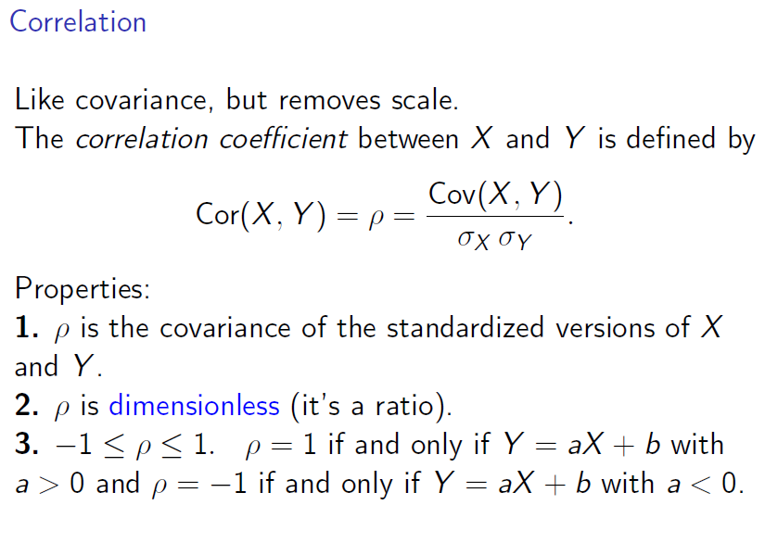

Slide 33
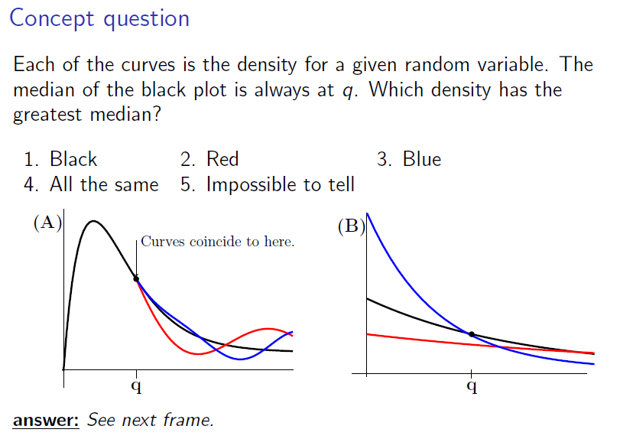

Slide 34
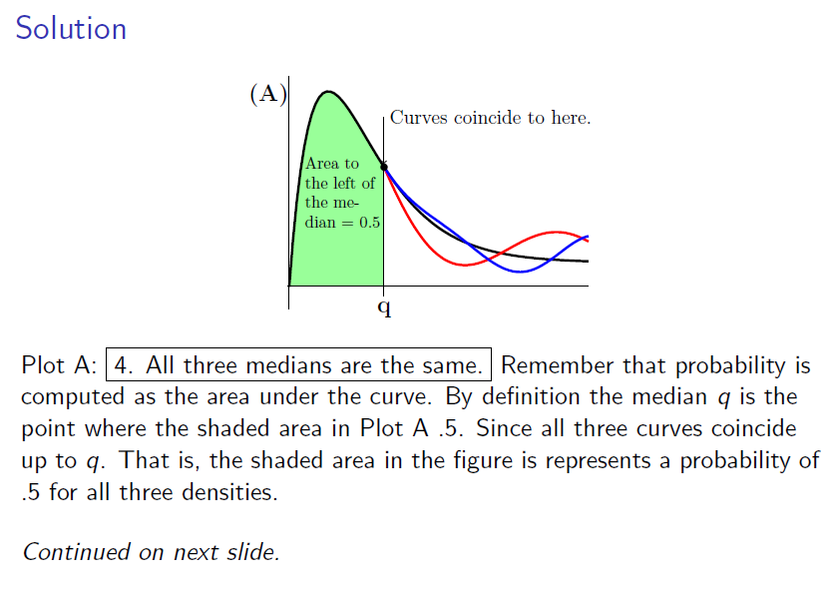

Slide 35
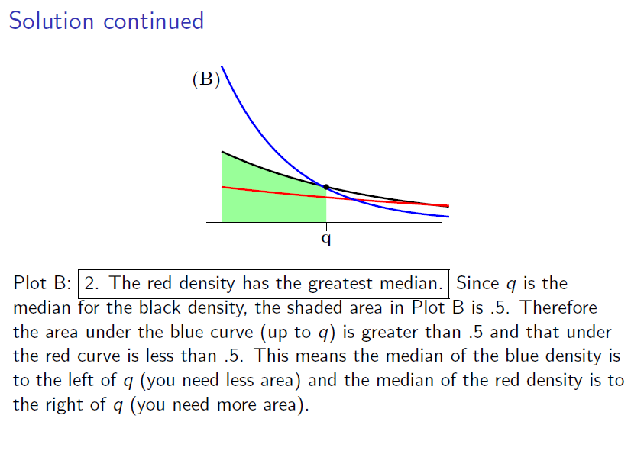

Slide 36
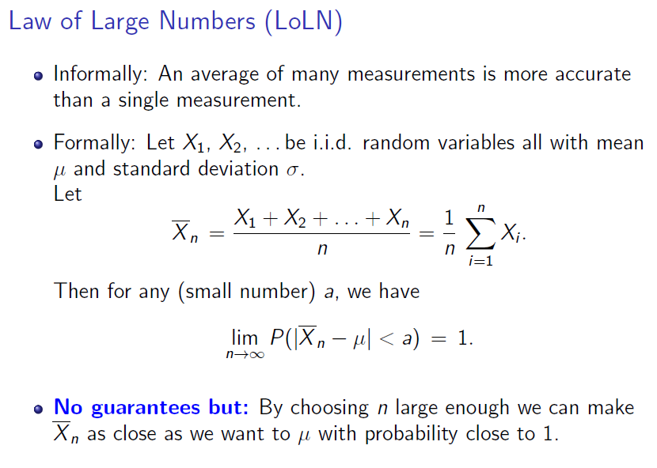

Slide 37
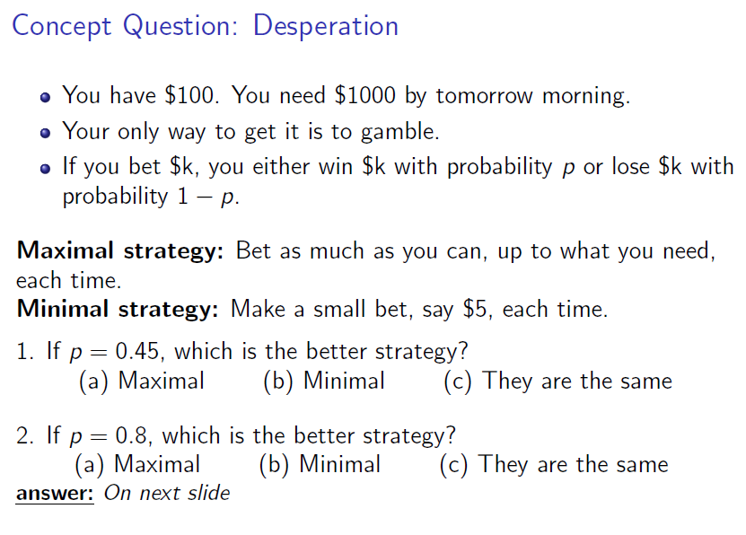

Slide 38
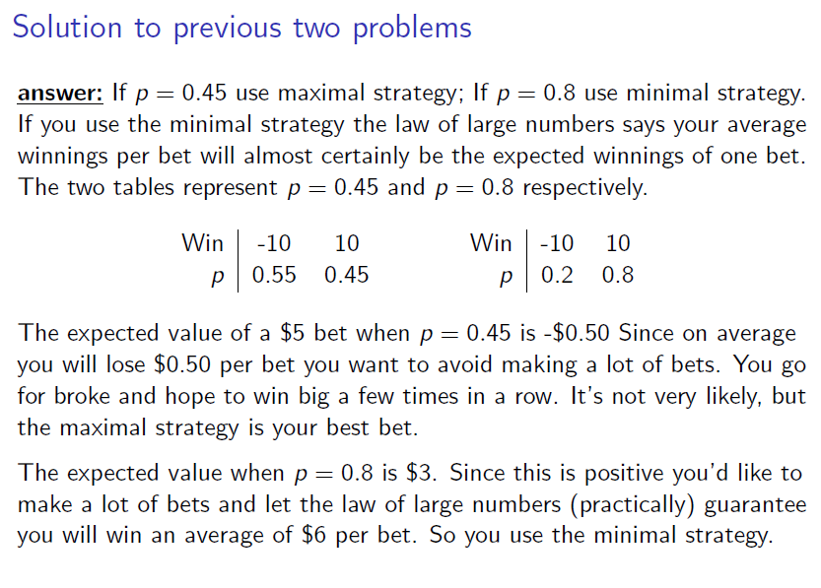

Slide 39
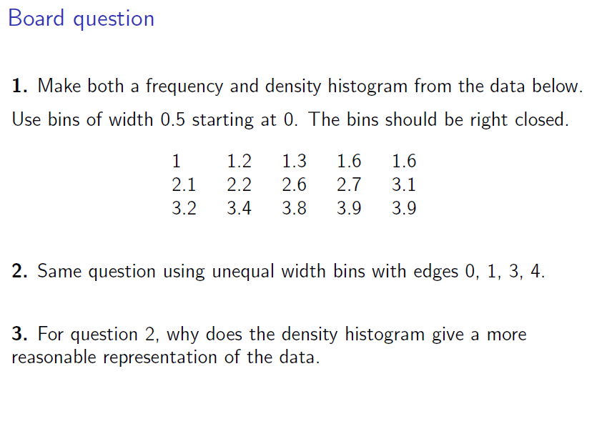

Slide 40
